Slide 1
Mining Massive Datasets
Wu-Jun Li
Department of Computer Science and Engineering
Shanghai Jiao Tong University
Lecture 1: Introduction

Slide 2
Outline
Data intensive scalable computing (DISC)
Data mining
Notes:
Grep is line-oriented; IR is document oriented.

Slide 3

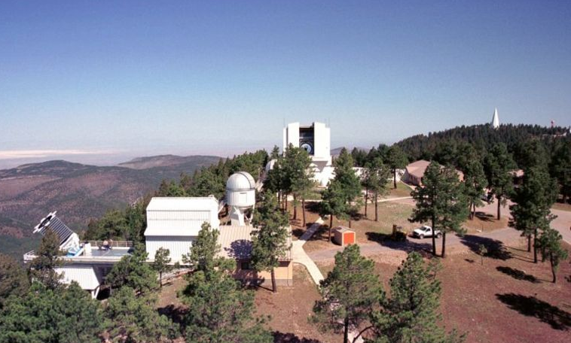

Examples of Massive Data Sources
DISC
Wal-Mart
  267 million items/day, sold at 6,000 stores
  HP building them 4PB data warehouse
  Mine data to manage supply chain, understand market trends, formulate pricing strategies
Sloan Digital Sky Survey
  New Mexico telescope captures 200 GB image data / day
  Latest dataset release: 10 TB, 287 million celestial objects
  SkyServer provides SQL access

Slide 4
Our Data-Driven World
DISC
Science
  Data bases from astronomy, genomics, natural languages, seismic modeling, …
Humanities
  Scanned books, historic documents, …
Commerce
  Corporate sales, stock market transactions, census, airline traffic, …
Entertainment
  Internet images, Hollywood movies, MP3 files, …
Medicine
  MRI & CT scans, patient records, …

Slide 5
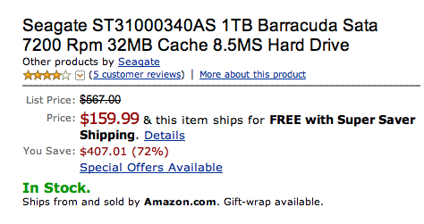
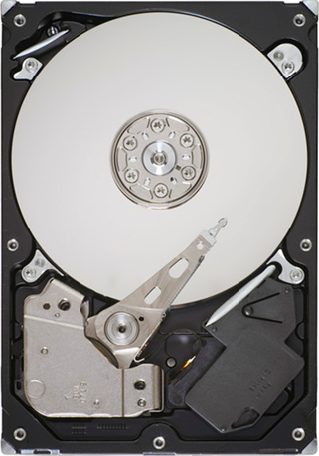
Why So Much Data?
DISC
We Can Get It
  Automation + Internet
We Can Keep It
  1 TB @ $159 (16¢ / GB)
We Can Use It
  Scientific breakthroughs
  Business process efficiencies
  Realistic special effects
  Better health care
Could We Do More?
  Apply more computing power to this data

Slide 6
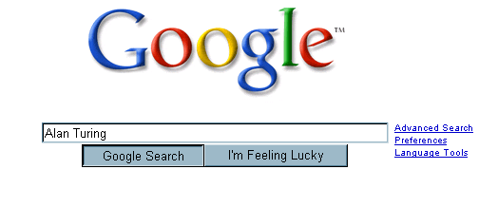
Google’s Computing Infrastructure
DISC
  200+ processors
  200+ terabyte database
  10¹⁰ total clock cycles
  0.1 second response time
  5¢ average advertising revenue

Slide 7
Google’s Computing Infrastructure
DISC
System
  ~ 3 million processors in clusters of ~2000 processors each
  Commodity parts
    x86 processors, IDE disks, Ethernet communications
    Gain reliability through redundancy & software management
  Partitioned workload
    Data: Web pages, indices distributed across processors
    Function: crawling, index generation, index search, document retrieval, Ad placement
A Data-Intensive Scalable Computer (DISC)
  Large-scale computer centered around data
    Collecting, maintaining, indexing, computing
  Similar systems at Microsoft & Yahoo
Barroso, Dean, Hölzle, “Web Search for a Planet: The Google Cluster Architecture” IEEE Micro 2003

Slide 8
DISC: Beyond Web Search
DISC
Data-Intensive Application Domains
  Rely on large, ever-changing data sets
    Collecting & maintaining data is major effort
  Many possibilities
Computational Requirements
  From simple queries to large-scale analyses
  Require parallel processing
  Want to program at abstract level
Hypothesis
  Can apply DISC to many other application domains

Slide 9
Data-Intensive System Challenge
DISC
For Computation That Accesses 1 TB in 5 minutes
  Data distributed over 100+ disks
    Assuming uniform data partitioning
  Compute using 100+ processors
  Connected by gigabit Ethernet (or equivalent)
System Requirements
  Lots of disks
  Lots of processors
  Located in close proximity
    Within reach of fast, local-area network

Slide 10
Desiderate for DISC Systems
DISC
Focus on Data
  Terabytes, not tera-FLOPS
Problem-Centric Programming
  Platform-independent expression of data parallelism
Interactive Access
  From simple queries to massive computations
Robust Fault Tolerance
  Component failures are handled as routine events
Contrast to existing supercomputer / HPC systems

Slide 11

Topics of DISC
DISC
Architecture
  Cloud computing
Operating Systems
  Hadoop
  Apsara (飞天） by Aliyun
  (http://blog.aliyun.com/?p=181)
  http://www.aliyun.com/
Programming Models
  MapReduce
Data Analysis (Data Mining)

Slide 12
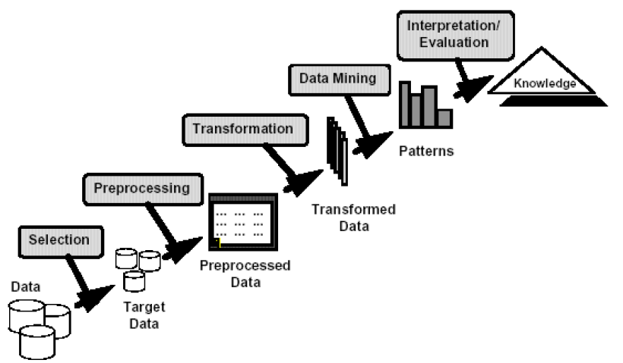
What is Data Mining?
Data Mining
Non-trivial discovery of implicit, previously unknown, and useful knowledge from massive data.

Slide 13
Cultures
Data Mining
Databases:
  concentrate on large-scale (non-main-memory) data.
AI (machine-learning):
  concentrate on complex methods, small data.
Statistics:
  concentrate on models.
Statistics
AI/
Machine Learning
Data Mining
Databases

Slide 14
Models vs. Analytic Processing
Data Mining
To a database person, data-mining is an extreme form of analytic processing – queries that examine large amounts of data.
  Result is the query answer.
To a statistician, data-mining is the inference of models.
  Result is the parameters of the model.

Slide 15
(Way too Simple) Example
Data Mining
Given a billion numbers, a DB person would compute their average and standard deviation.
A statistician might fit the billion points to the best Gaussian distribution and report the mean and standard deviation of that distribution.

Slide 16
Data Mining Tasks
Data Mining
Association rule discovery
Classification
Clustering
Recommendation systems
  Collaborative filtering
Link analysis and graph mining
Managing Web advertisements
… …

Slide 17
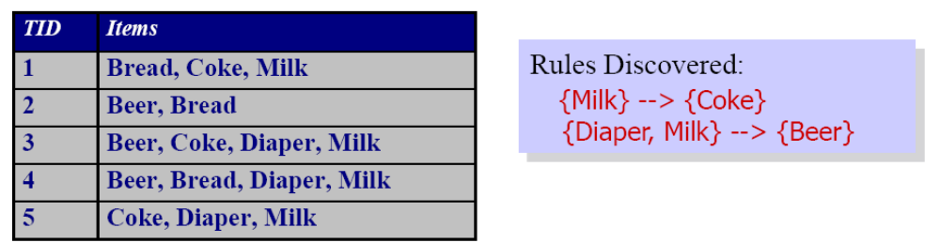
Association Rule Discovery
Data Mining

Slide 18
Classification
Data Mining
Government
Science
Arts

Slide 19
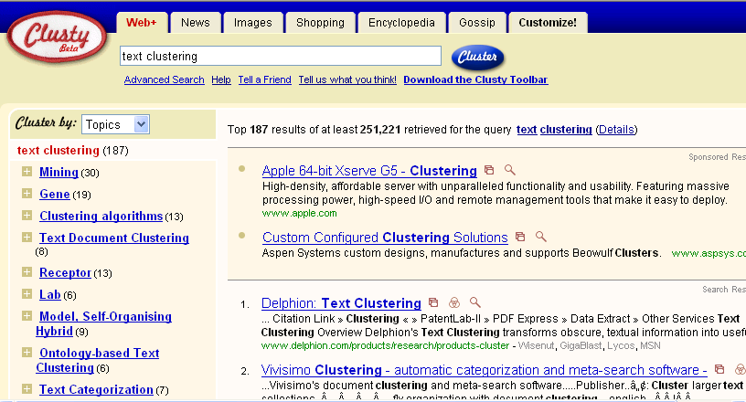
Clustering
Data Mining

Slide 20
Recommender Systems
Data Mining
Netflix
  Movie recommendation
Amazon
  Book recommendation

Slide 21
Link Analysis and Graph mining
Data Mining
PageRank
Link prediction
Community detection

Slide 22
Meaningfulness of Answers
Data Mining
A big data-mining risk is that you will “discover” patterns that are meaningless.
Statisticians call it Bonferroni’s principle: (roughly) if you look in more places for interesting patterns than your amount of data will support, you are bound to find crap.

Slide 23
Examples of Bonferroni’s Principle
Data Mining
A big objection to Total Information
Awareness (TIA) was that it was looking for so many vague connections that it was sure to find things that were bogus and thus violate innocents’ privacy.
The Rhine Paradox: a great example of how not to conduct scientific research.

Slide 24
The “TIA” Story
Data Mining
Suppose we believe that certain groups of evil-doers are meeting occasionally in hotels to plot doing evil.
We want to find (unrelated) people who at least twice have stayed at the same hotel on the same day.

Slide 25
The “TIA” Story
Data Mining
10⁹ people being tracked.
1000 days.
Each person stays in a hotel 1% of the time (10 days out of 1000).
Hotels hold 100 people (so 10⁵ hotels).
If everyone behaves randomly (I.e., no evil-doers) will the data mining detect anything suspicious?

Slide 26
The “TIA” Story
Data Mining
Probability that p and q will be at the same hotel on one specific day:
  (1/100) × (1/100) × (1/ 10⁵ )= 10⁻⁹
Probability that p and q will be at the same hotel on some two days:
  5×10⁵ × (10⁻⁹ × 10⁻⁹) = 5×10⁻¹³.
  (Pairs of days is 5×10⁵ )
Pairs of people:
  5×10¹⁷.
Expected number of “suspicious” pairs of people:
  5×10¹⁷ × 5×10⁻¹³ = 250,000.

Slide 27
Conclusion
Data Mining
Suppose there are (say) 10 pairs of evil-doers who definitely stayed at the same hotel twice.
Analysts have to sift through 250,010 candidates to find the 10 real cases.
  Not gonna happen.
  But how can we improve the scheme?

Slide 28
Moral
Data Mining
When looking for a property (e.g., “two people stayed at the same hotel twice”), make sure that the property does not allow so many possibilities that random data will surely produce facts “of interest.”

Slide 29
Rhine Paradox – (1)
Data Mining
Joseph Rhine was a parapsychologist in the 1950’s who hypothesized that some people had Extra-Sensory Perception (ESP).
He devised (something like) an experiment where subjects were asked to guess 10 hidden cards – red or blue.
He discovered that almost 1 in 1000 had ESP – they were able to get all 10 right!

Slide 30
Rhine Paradox – (2)
Data Mining
He told these people they had ESP and called them in for another test of the same type.
Alas, he discovered that almost all of them had lost their ESP.
What did he conclude?
  Answer on next slide.

Slide 31
Rhine Paradox – (3)
Data Mining
He concluded that you shouldn’t tell people they have ESP; it causes them to lose it.

Slide 32
Moral
Data Mining
Understanding Bonferroni’s Principle will help you look a little less stupid than a parapsychologist.

Slide 33
Applications
Data Mining
Banking: loan/credit card approval
  Predict good customers based on old customers
Customer relationship management
  Identify those who are likely to leave for a competitor
Targeted marketing
  Identify likely responders to promotions
Fraud detection:
  From an online stream of event identify fraudulent events
Manufacturing and production
  Automatically adjust knobs when process parameter changes

Slide 34
Applications (continued)
Data Mining
Medicine: disease outcome, effectiveness of treatments
  Analyze patient disease history: find relationship between disease
Scientific data analysis
  Gene analysis
Web site/store design and promotion
  Find affinity of visitor to pages and modify layout

Slide 35
Questions?

Slide 36
Acknowledgement
Some slides are from:
  Prof. Jeffrey D. Ullman
  Dr. Jure Leskovec
  Prof. Randal E. Bryant

